Slide 1
Don’t rain on my … bike ride?
UNC Data Science Boot Camp
Project #1
07/13/2019

Slide 2
Agenda
Introductions
Research Questions
Data Cleansing
Findings
Future Implications
Notes:
Data sources - https://pngimage.net/source-png-8/

Slide 3




Project Team
Meg Sharma
Vinnie Philip
Josh #1
(aka Josh Bosse)
Josh #2
(aka Josh Seymour)

Slide 4

Things that make you go, hmmm
Does weather affect participation in bike-share programs?
What type of weather impacts use of bike-share programs?

Slide 5



Pedaling Down the Pipeline
Data Sources

Slide 6

Pedaling Down the Pipeline
Bike Data
Data Sources
Notes:
1. Read in monthly bike data from our resources for boston and portland
2. cleaned and standardized
1. -dropped and renamed columns and converted to date time
2. created aggregates to apply functions to columns
3. merged months for both cities then exported to resources file
4. read in weather data for boston and portland from resources
1. -converted to fahrenheit
2. -dropped duplicates
3. -created aggregates to apply functions to columns

Slide 7
Pedaling Down the Pipeline
Bike Data
Data Sources
Weather Data
Notes:
5. Created two weather datasets for both cities
1. Hour and daily
6. exported all hourly and daily weather data for boston and portland

Slide 8

Pedaling Down the Pipeline
Bike Data
Merged Data
Data Sources
Weather Data
Notes:
7. read in merged bike files and hourly weather files from resources
8. Merged bike data files for both cities with hourly weather cvs files from weather data
9. grouped by month, day, and hour for each merged file
10. Then exported all six files to resources (had Hourly daily and monthly for each city: totaling 6 files)

Slide 9

Pedaling Down the Pipeline
Bike Data
Merged Data
Data Sources
Weather Data
Analyze & Visualize
Notes:
1. called for files from resources and exported to output _images

Slide 10


Slide 11
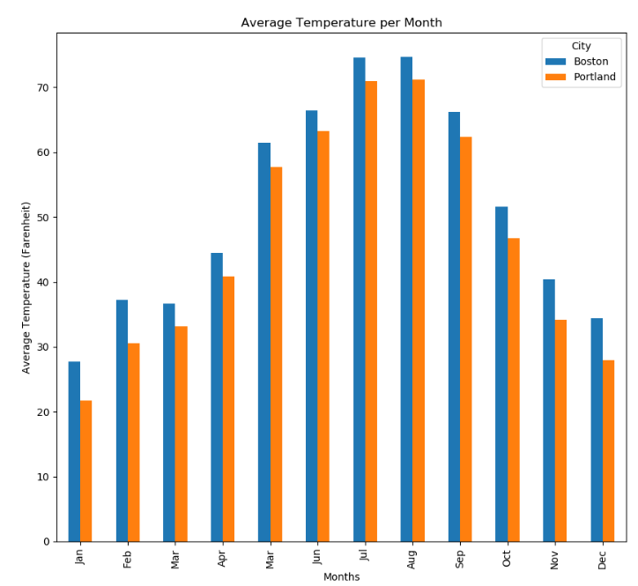
Month: Average Temp
Boston and Portland Data look similar
The curve of the bar graph chart are alike
Both cities have similar weather patterns throughout month

Slide 12
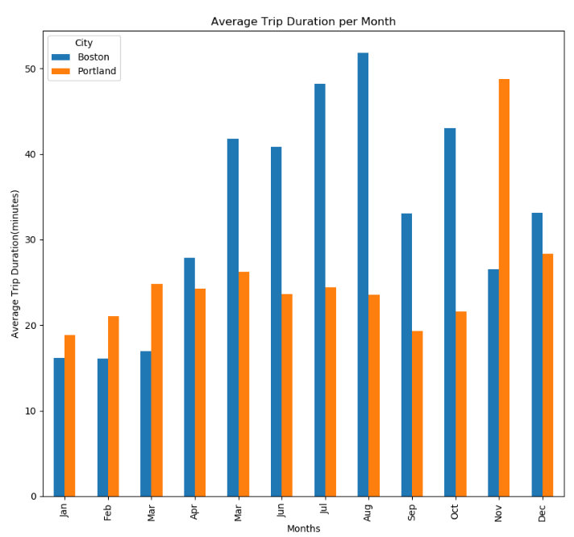
Month: Average Trip Duration
Boston has a higher Average Trip Duration per month overall
Portland has a significant rise during the month of November

Slide 13
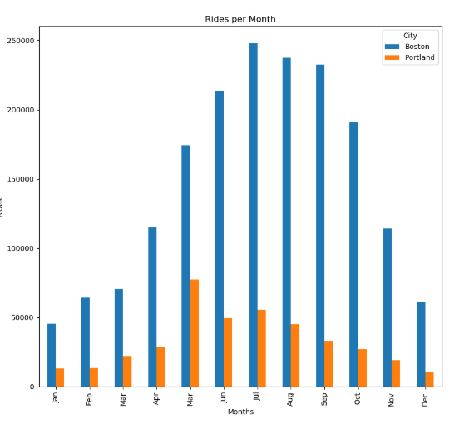
Month: Count of Rides
Boston has a greater count of rides per month than Portland

Slide 14
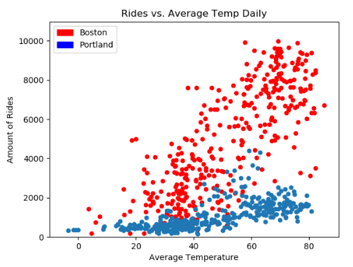
Daily: Impact of Temperature on Rides
Boston’s ride count increased exponentially as temperature increased.
Portland’s ride count increased as temperature increased but not much greater than in the colder temperatures.
Notes:
Portland, OR
Launched July 2016
125 stations
1000 bikes
Boston, MA
Launched in 2011
260+ stations
2,500+ bikes
Even though ride count in Portland increased as temperature increased it was not as big of a change as Boston’s.
This could be due to several factors such as: population(about a 40k difference), personal bike ownership, access to bike sharing.

Slide 15
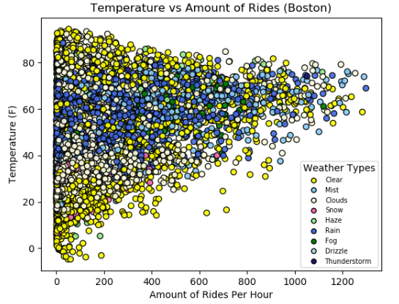
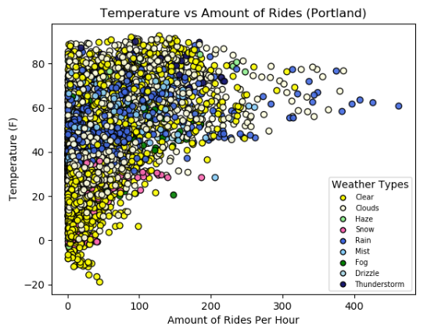
Hour: Ride Count by Weather Type

Slide 16
conclusions
Additional questions:
Participation in bike share within cities (Latitude and Longitude)
Unique user type for each city
Annual revenue for each city
Development efforts
Coding standards
Naming conventions
Writing style
Commenting
Master branching

Slide 17


